Slide 1
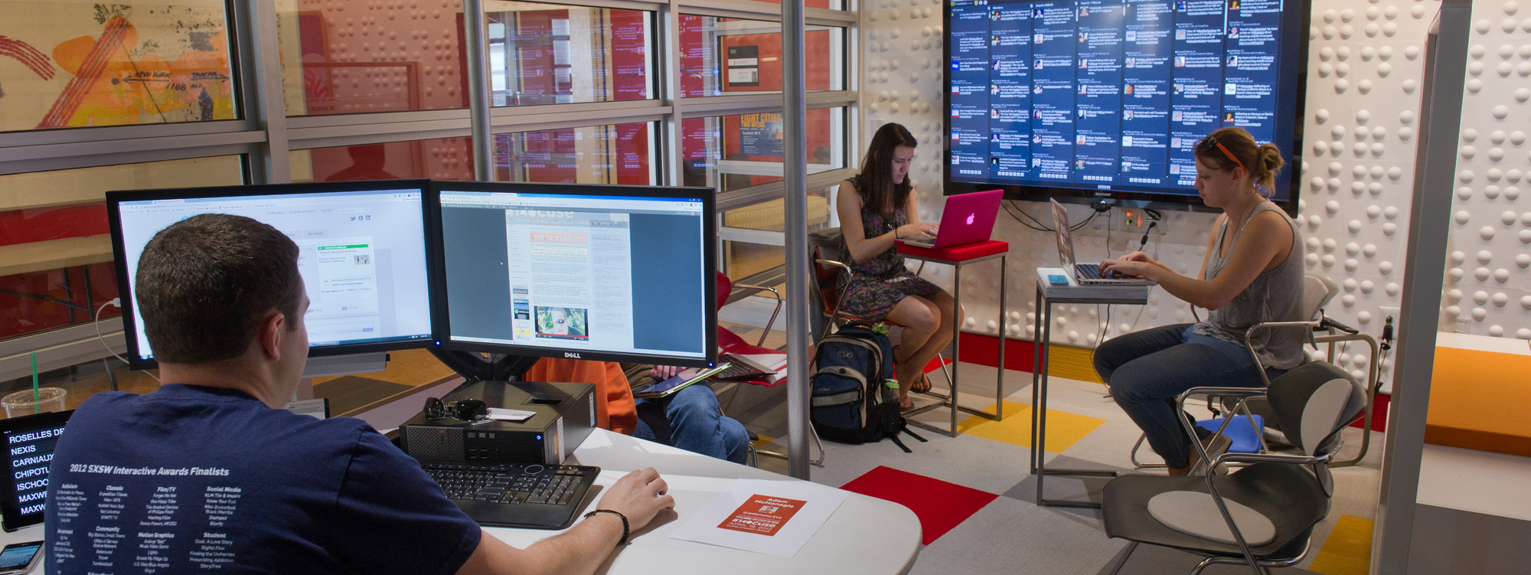
Applied Data Science Harsh | Jash | Shrutik | Charan | Priyanka

Slide 2
OVERVIEW
Problem Statement
Scope

Slide 3
PROBLEM STATEMENT
Performing data analysis to find out prime reasons for existing customers to not recommend the hotel based on their stay
Scope of our project is limited to hotels in United States
Focus is on those customers whose likelihood to recommend is less than 8 (Passive and Detractors customers)

Slide 4
Top 5 Cities with most Detractors
City | Detractors | Passive
San Francisco | 19% | 26%
Atlanta | 12% | 17%
New York | 11% | 26%
San Diego | 10% | 19%
San Antonio | 9% | 25%

Slide 5
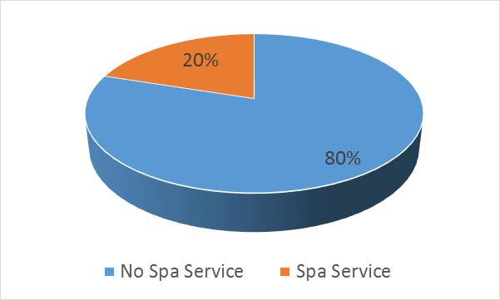
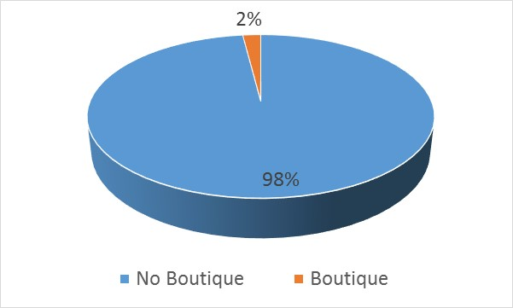
Sample Queries Results
80% of the customers (couples) whose purpose of visit was Leisure could be detractors because the hotel had no Spa Service
98% of the Female customers whose purpose of visit was Leisure might be detractors because the hotel had no Boutique

Slide 6
Sample Queries Results
73% of the Detractors in San Diego who visited for Business purpose were possibly detractors because of poor guest rooms
70% of the Detractors in San Francisco who visited for Business were possibly detractors because of poor Hotel Conditions

